Slide 1
Early life exposure and pubertal development: The DNBC Puberty cohort professor of epidemiology
Cecilia høst ramlau-Hansen, MHSc, PhD department of public health
Aarhus university, denmark

Slide 2
Epidemiological methods to study early life exposures and later health and disease

Slide 3
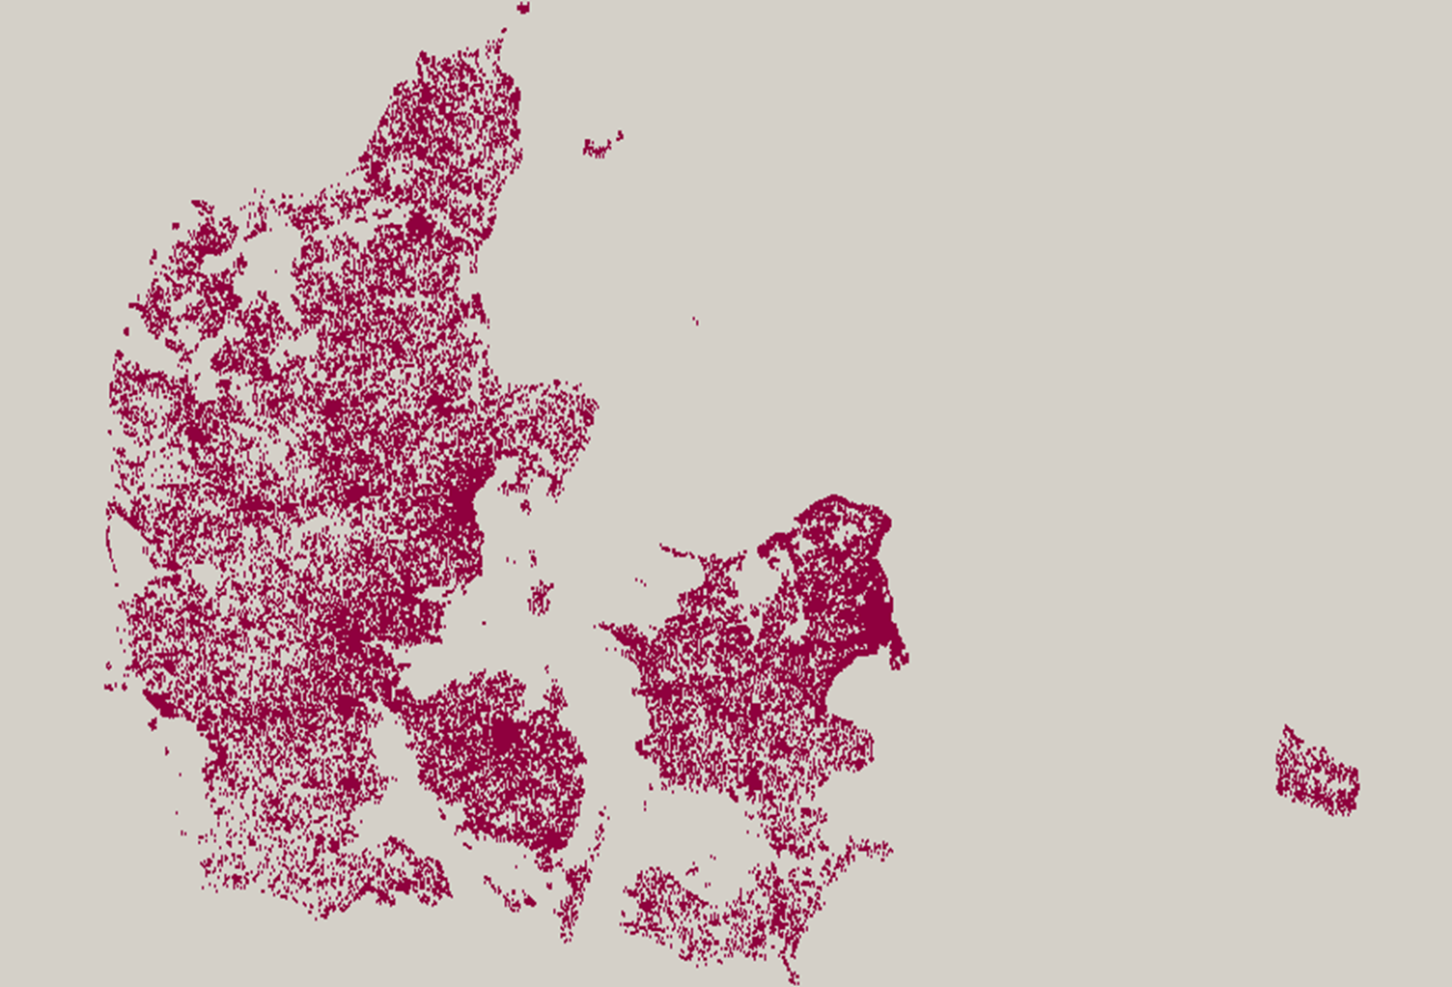

The danish national birth cohort
101,000 conceptions
Recruited 1996-2002
Prof. Jørn Olsen,
Aarhus University

Slide 4
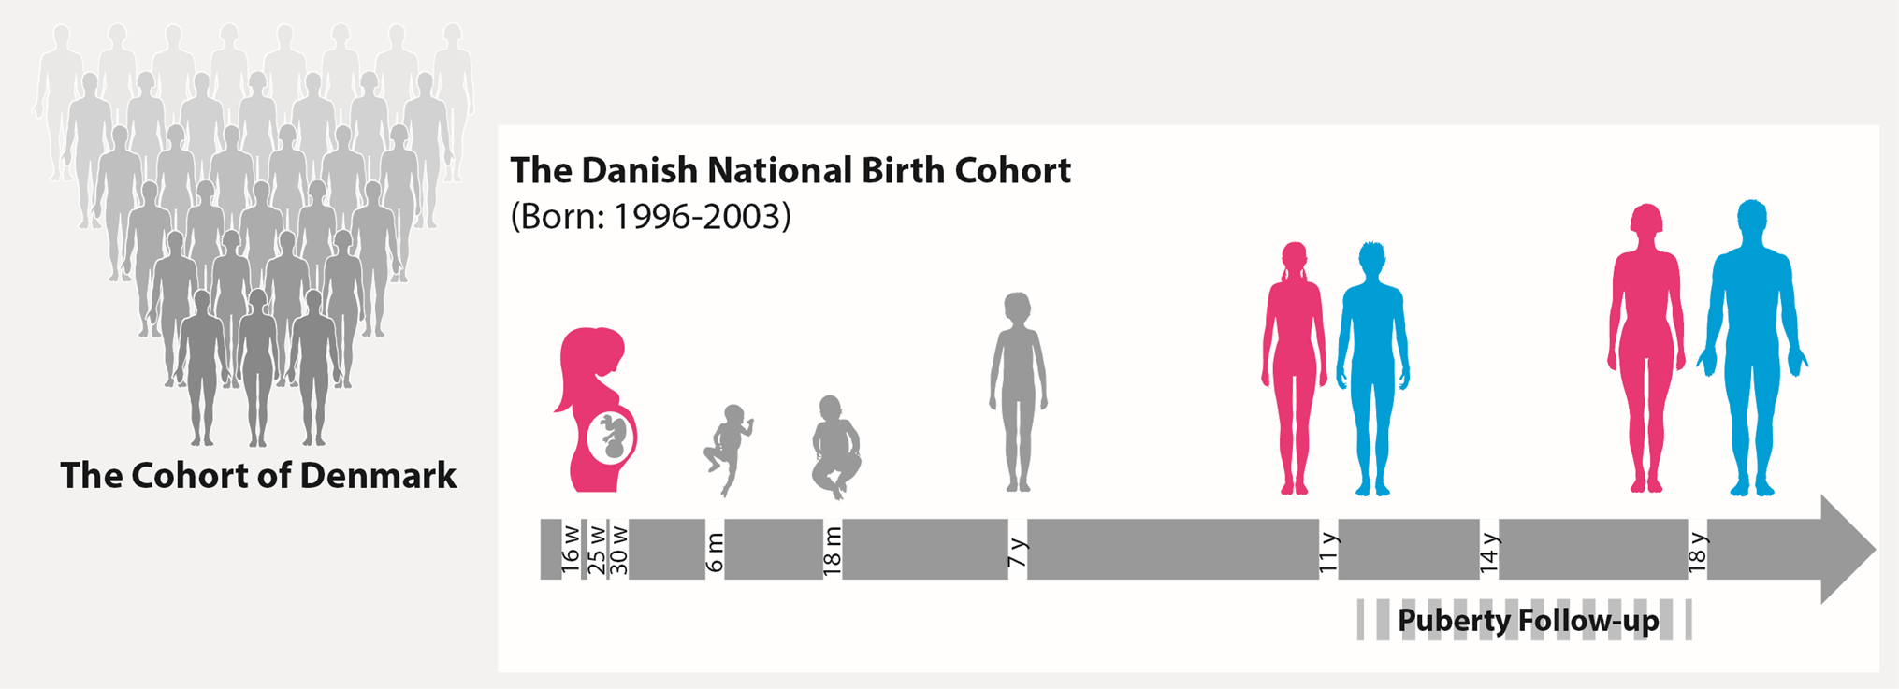
The danish national birth cohort, 2022
Median age: 22 years
More than 90,000 young participants

Slide 5
Puberty and the DNBC puberty cohort

Slide 6
secular trend in age at menarche
Parent et al., Front Neuroendocrinol 2015

Slide 7
Timing of puberty: age at menarche
Age at menarche occurred in our study (2019) 3 months earlier in daughters than in mothers
Age at menarche
Year
Reproduction after Styne & Grumbach, Williams Textbook of Endocronology 2015, Aksglæde et al. 2009 and Brix et al. 2018.

Slide 8
Boys: age at onset of puberty (G2)
Other milestones attained 6-12 months earlier in our study (2018) than previously
Age at onset of testicular growth (TG2)
Year
Reproduction after Sørensen et al., 2010, Lindgren, G., 1996 and Brix et al., 2018.

Slide 9
IS IT IMPORTANT?
Psychopathology
?
Early
puberty
Cardiovascular diseases
Testicular cancer and breast cancer
Freedman et al, BMC pediatr 2003
Day et al, Sci Rep 2015
Berkey et al, Cancer 1999
Moss et al, Epidemiol 1986
Ullsperger et al, Psycol Bull 2017
Obesity
Diabetes

Slide 10
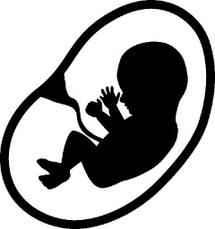
DETERMINANTS OF PUBERTAL TIMING?
Childhood obesity
Genetics
?
Prenatal causes?
We have investigated:
Maternal lifestyle during pregnancy Endocrine disruptors
Maternal diseases
Social and psychological factors
Early
puberty
Nutrition
?
Living conditions

Slide 11
the dnbc puberty cohort
Ernst et al, IJE 2020

Slide 12
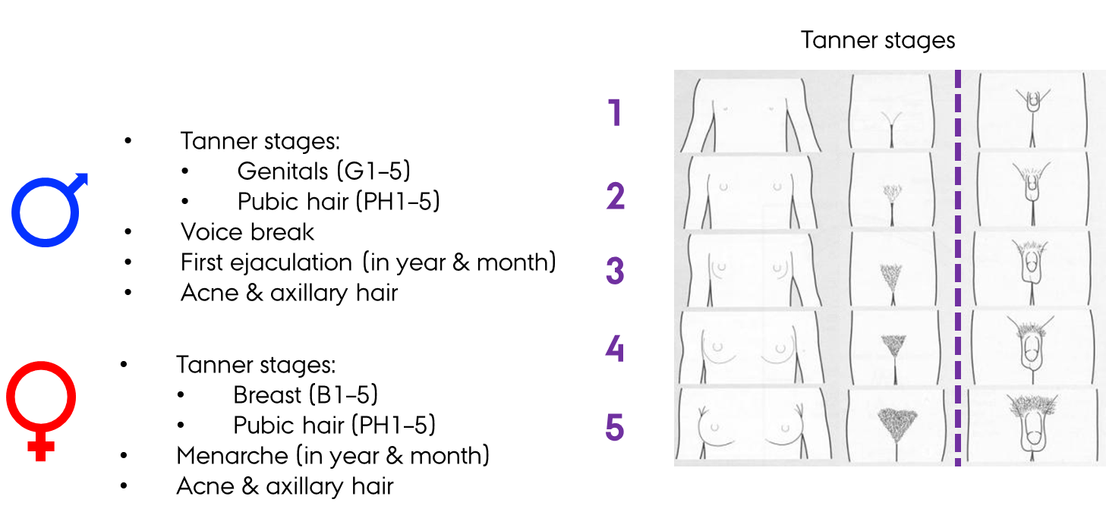
Web-based Questionnaire on puberty
Half-yearly information on:
Notes:
A web-based questionnaire on pubertal development was sendt to the children in the Puberty Cohort every six months
It included questions on a range of pubertal markers, including
Age at menarch, age a first ejaculation, voice break, heigh, and we also asked the children to indicate which Tanner stage they matched the best, as you have done in the Alspac.
Here are the drawings and text for pubic hair development for boys and breast development for girls.
Stage 1 is before oneset of puberty, and in stage 5 you are fully sexually matured.

Slide 13
Flowchart of the puberty cohort
Singletons Born in DNBC between 2000 - 2003 (n=61,071)
Withdrawn from the DNBC (n=969)
Mothers Not Completed First Telephone Interview in DNBC (n=3,461)
Participants Eligible for the Puberty Cohort (n=56,641)
Not Sampled for the Puberty Cohort (n=34,202)
Participants Sampled for the Puberty Cohort (n=22,439)
Withdrawn consent (n=3)
Puberty Cohort
Follow-up
No Questionnaires Returned n=7,680)
No Reply to Questionnaire (n=10,964)
No Information on Puberty in Questionnaire Returned (n=807)
11-year follow-up
Participants with Information on Puberty
N=15,819 (70 %)
(67% boys and 74% girls)
Boys: 5.5 Q per participant (1-14)
Girls: 6.5 Q per participant (1-15)

Slide 14

Validation study: information bias?
Design: Cross-sectional study (715 invited)
  Test-retest (consistency)
  Self-report vs. clinical Tanner staging (reliability)

Slide 15
Validation study: information bias?
CONCLUSION:
Fair degree of agreement between self-report and clinical examinations
No consistent tendencies to overestimation or underestimation
Ernst et al, J Pediatr Endocrinol Metab. 2018

Slide 16
Validation Study: selection bias?
Aim: To explore selection bias in the Puberty Cohort
Notes:
We also conducted a validation study to assess the risk of selection bias in the DNBC Puberty Cohort.

Slide 17
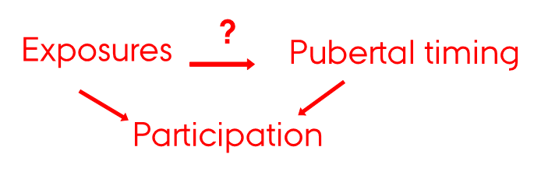
Validation Study: selection bias?
Aim: To explore selection bias in the Puberty Cohort
Notes:
We

Slide 18
Validation Study: selection bias?
Aim: To explore selection bias in the Puberty Cohort

Slide 19
Validation Study: selection bias?
Aim: To explore selection bias in the Puberty Cohort
Notes:
Based on this, we can remove the arrow in the DAG
Fra Nis (methods):
Height difference in standard deviations (HD:SDS)
HD:SDS is a. HD:SDS is the difference between pubertal height (measured around the average age at peak height velocity (PHV) on the population level) in standard deviation scores (SDS) and adult height in SDS. The rationale is that pubertal height SDS is mainly influenced by timing of puberty and the genetic growth potential, whereas adult height SDS is mainly influenced by the genetic growth potential only.11 By taking the difference between pubertal height SDS and adult height SDS, the genetic growth potential is in theory removed, and the resulting measure, HD:SDS, is considered mainly influences by timing of puberty.11 A child with early puberty will, on average, have an earlier age at PHV, resulting in a higher pubertal height SDS, and consequently a higher HD:SDS than a child with normally timed puberty. Conversely, a child with later puberty will have a lower HD:SDS. HD:SDS correlates well with age at PHV and onset of the growth spurt.11 Pubertal height was obtained from the Children’s Database (n = 17,276) as the height measure nearest to 13 years (+/- 2 years) in boys and 11 years (+/- 2 years) in girls, and was then converted to SDS.3,10 As our children were not fully grown yet, we had to predict the children’s adult height based on parental height (reported by mothers during the first interview in the DNBC). To predict adult height, we used a prediction algorithm based on a Swedish material, and then adult height was converted to SDS.10,13 As parental height was not available for all children, HD:SDS was available on 16,766 (75%) of all 22,439 children in the Puberty Cohort. We have previously validated this modified version of HD:SDS, which relied on predicted adult height, against age at attaining the pubertal milestones in the Puberty Cohort (ref HD:SDS). We found correlations within the expected range, indicating that HD:SDS appears to be a reasonable marker of pubertal timing (ref HD:SDS).
Fra Nis (results):
Study 6: risk of selection bias in the Puberty Cohort
Potential exposures and baseline characteristics were associated with participation; mothers of participating children were more often normal weight, non-smokers, older at delivery, and had a higher parental educational class than mothers of non-participating children.3 Pubertal timing, measured by HD:SDS, was not associated with participation, both in crude and adjusted analyses (Figure 10).
Associations for maternal smoking in pregnancy, alcohol intake in pregnancy, and pre-pregnancy obesity with HD:SDS are presented in Table 4 for the entire Puberty Cohort (participants and non-participants, and, hence, with minimal risk of selection bias) and for participants only (at risk of selection bias). The difference in estimates between participants only and the entire Puberty Cohort is a quantification of selection bias (Table 4). Overall, the differences showed no or minimal risk of selection bias.

Slide 20

Validation Study: selection bias?
Aim: To explore selection bias in the Puberty Cohort
Findings:
1. Exposures associated with participation
2. Pubertal timing NOT associated with participation
3. Similar exposure-outcome associations for
participants and entire Puberty Cohort
Conclusion: minimal risk of selection bias
Brix et al, Paediatr Perinat Epidemiol. 2020

Slide 21
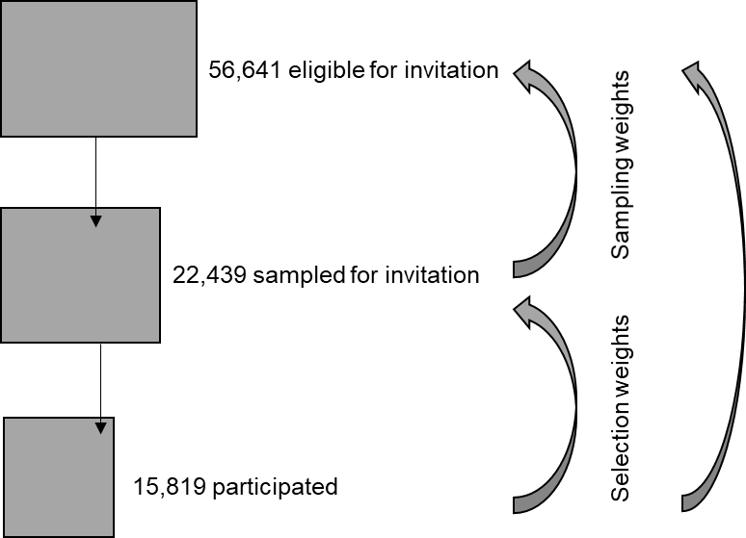
Sampling and selection weights
Sampling weights to account for non-random sampling to the Puberty cohort: Calculated the inverse probabilities for being sampled → created a pseudo population that on average represents all 56,641 eligible
Selection weights to account for non-participation in the Puberty cohort: Calculated the inverse probabilities for participation→ created a pseudo population that on average represents all 22,439 invited

Slide 22
maternal and childhood Obesity and timing of puberty

Slide 24
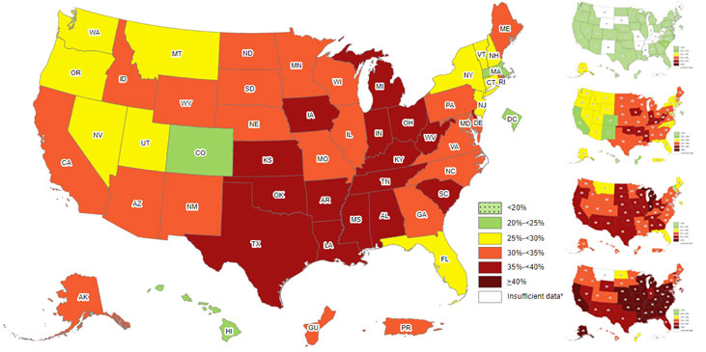
U.S. Adults, self-reported obesity 2020
Source: CDC

Slide 25

CHILDHOOD OBESITY AND PUBERTY
Hyperinsulinism and increased bioavailability of sex hormones
Leptin and ghrelin
Accumulation of endocrine disruptors in adipose tissue
Several epidemiological studies find obese girls to have earlier age at menarche and onset of breast development than normal-weight girls
Studies on boys find conflicting results
Previous findings may be confounded by genetic factors and socioeconomic factors

Slide 26
Aim:
To study the association between childhood body mass index and timing of puberty using a cohort design and a sibling-matched design

Slide 27
SIBLING-MATCHED DESIGN
To remove confounding by time-stable and shared factors between siblings

Slide 28
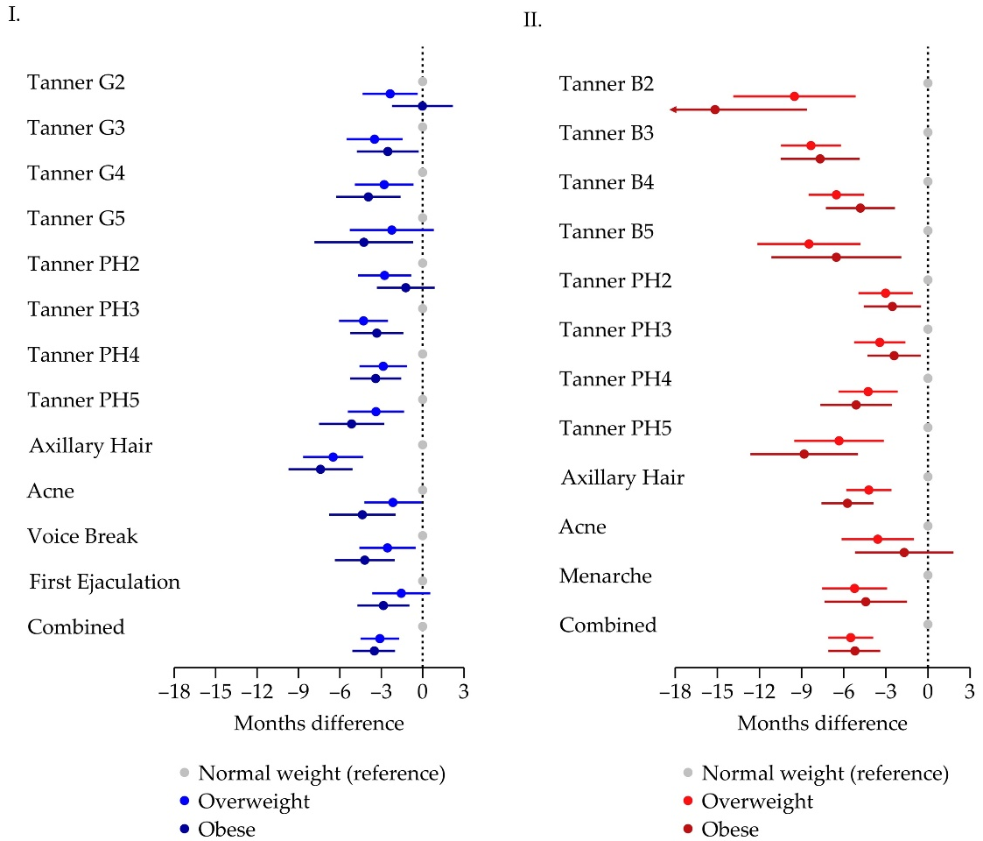
CHILDHOOD OBESITY - RESULTS
In cohort analysis: N = 11,046 (49 % of invited)
In sibling-matched design: 888 brothers and 812 sisters
Sibling analysis:
Supported findings from cohort analysis
‘Combined’: A single estimate of the average difference in age at attaining the pubertal milestones by simultaneously modelling all pubertal milestones using Hüber-White robust variance estimation

Slide 29
CONCLUSIONS
Childhood overweight and obesity were associated with earlier puberty in a dose-dependent manner in boys and girls in the cohort analysis.
Higher childhood body mass index was associated with earlier puberty even after adjustment for unobserved time-stable confounders shared within families in the sibling-matched analysis of sisters.

Slide 30
DETERMINANTS OF PUBERTAL TIMING
Childhood obesity
Genetics
Prenatal causes?
?
Early
puberty
Nutrition
?
Living conditions

Slide 31
MATERNAL BMI AND PUBERTY
Several epidemiological studies support an association between maternal pre-pregnancy obesity and earlier age at menarche – and recently also earler onset of breast and pubic hair development
These associations seem to be partly mediated by childhood BMI in some, but not all studies
Only one study in boys – and this used recalled data on timing of pubertal markers
The potential mediating role of childhood BMI unknown for boys

Slide 32
Aim:
To explore the potential effect of maternal pre-pregnancy overweight and obesity on timing of puberty in sons and daughters

Slide 33
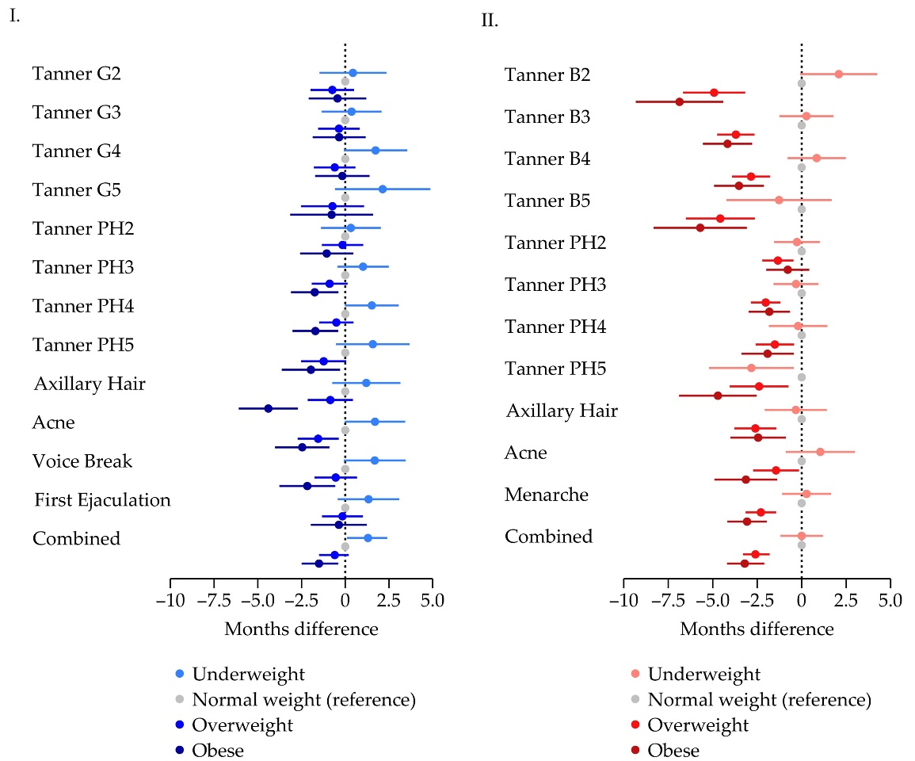
PRE-PREGNANYC OBESITY AND PUBERTY - RESULTS
Mediation by childhood BMI:
Sons: entire association
Daughters: 1/3 of association

Slide 34
CONCLUSIONS
Maternal pre-pregnancy obesity was associated with earlier age at voice break, pubic hair development, axillary hair and acne in sons.
Maternal pre-pregnancy obesity and overweight were associated with earlier age at menarche, breast development, pubic hair development, axillary hair and acne in daughters.
These associations seemed to be mediated through childhood obesity in sons and partly so in daughters.

Slide 35
Conclusions from the Puberty cohort
Supports an ongoing decline in pubertal age
No indication of severe information bias and limited risk of selection bias
Maternal genetic component for pubertal timing in both sexes
Supports programming of pubertal timing by early life exposures
Most exposures associated with earlier pubertal timing

Slide 37
LIMITATIONS OF THE PUBERTY COHORT
Non-participation in the Puberty Cohort (2012–2018): Participation rate ~70%
  But minimal risk of selection bias
A high proportion of children had already attained the early pubertal milestones at entry
  Interval censored regression analysis will give valid estimates, if the age at the early outcomes is normally distributed
Self-reported information on many of the exposures as well as puberty
  But exposure measured before the outcome
  and misclassification often most likely non-differential
Unmeasured and residual confounding
  But there are in some studies possibility to reduce risk of confounding by
    Applying a ‘sibling-matched design’ or an instrumental variable analysis

Slide 38
OTHER FINDINGS FROM THE PUBERTY COHORT

Slide 39
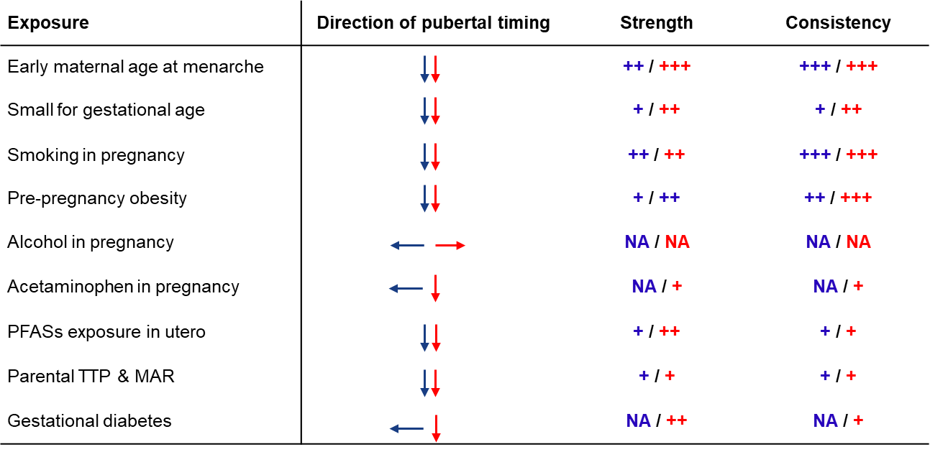
Early life EXPOSURES part one

Slide 40
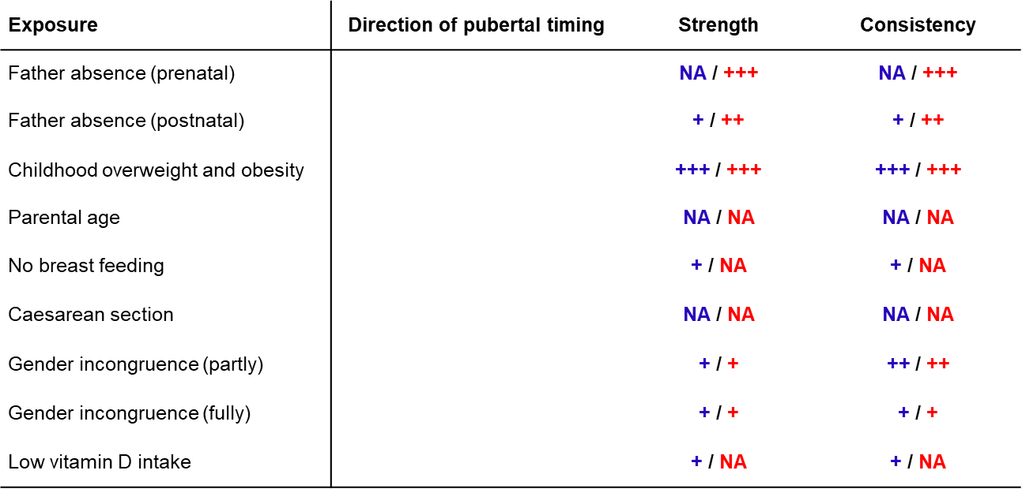

Early life exposures Part two

Slide 41
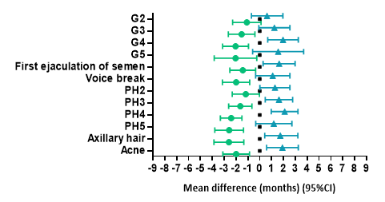
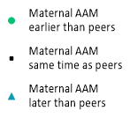
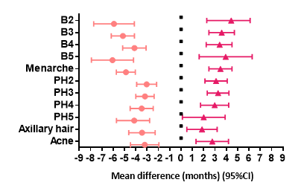
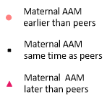
MATERNAL AGE At menarche and PUBERTY
Sons
Daughters

Slide 42
STRENGHTS OF THE PUBERTY COHORT
Large study size (~16,000)
High participation rate (70%)
Longitudinal collection of multiple pubertal milestones (~ 95,000 puberty questionnaires)
Detailed information on exposures and potential confounders
Possibility to link to the Danish registries by the unique personal identifier given at birth

Slide 43
Girls: Age at onset of puberty (B2)
Age at onset of breast development (TB2)
The Netherlands
Sweden
Denmark
Year
Reproduction after Juul et al., 2006, Aksglæde et al., 2009 and Brix et al., 2018.

Slide 44
Data structure
Had Tanner Breast stage 3 been achieved?
≈11.0 y – 1st Q
≈11.5 y – 2nd Q
≈12.0 y – 3rd Q
Data extraction
-
-
 |  |  |  | Lower limit | Upper limit
Left-censored | Yes | Yes | Yes | - | +
Right-censored | No | No | No | + | -
Inter-censored | No | No | Yes | + | +

Slide 45
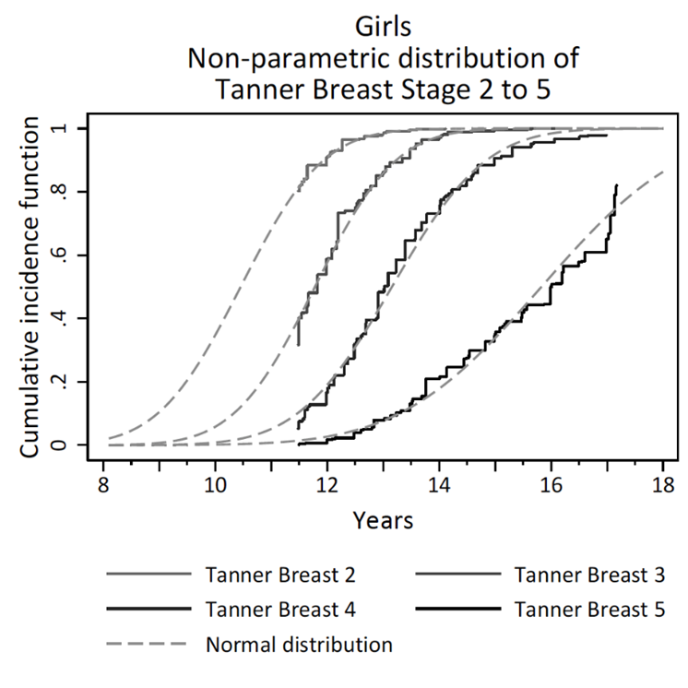
Data structure and statistical model
Interval-censored regression model for normally distributed time-to-event data

Slide 46
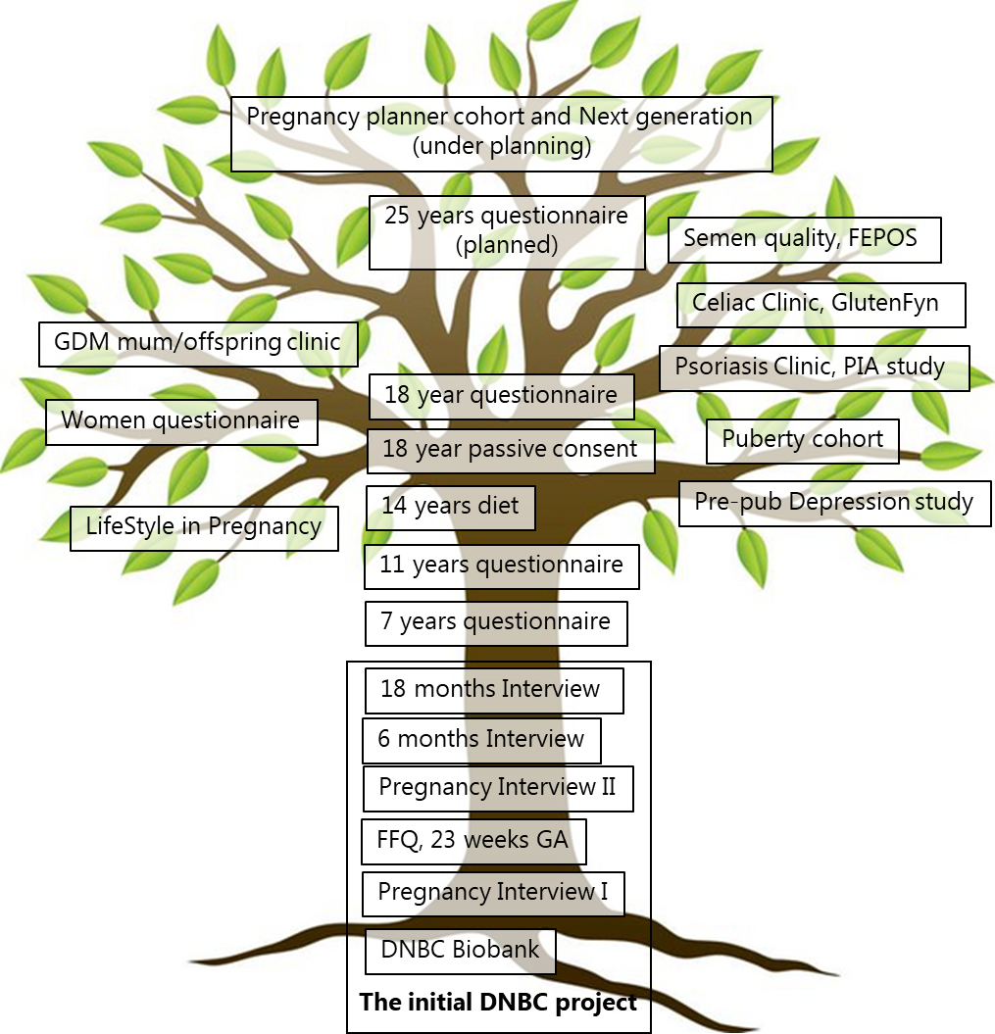
THE DNBC TREE
2022
Data collections within the DNBC framework
The central ‘trunk’ describes the data collections where the total cohort is invited

