Slide 1
The Schroll Prizes for excellence
2020 and 2021
Notes:
Thank you for letting me present the Schroll Prize to the first two prizewinners.
I am honored, that the committee for the Danish Epidemiological Society has chosen my name, SCHROLL, for the prize for excellence.
Apparently the reason is, that I 45 years ago, in 1975, took the initiative to start the Epidemiological Research Group, that expanded into the Danish Epidemiological Society, called DES
On the homepage of DES, you can read, that members have in common, that we are interested in epidemiological methods and their applications.
Minutes from one of your meetings states that “about 180 participants were gathered. The audience was inquisitive and the foreign presenters were impressed by the friendly atmosphere.”

Slide 2
The origins of
The Danish Epidemiological Society
Notes:
I have been allowed to give a presentation of the origins of DES and the early years:
It is exactly the interest in epidemiological methods, and the inquisitiveness in a friendly atmosphere that attracted young researchers from the very beginning.

Slide 3
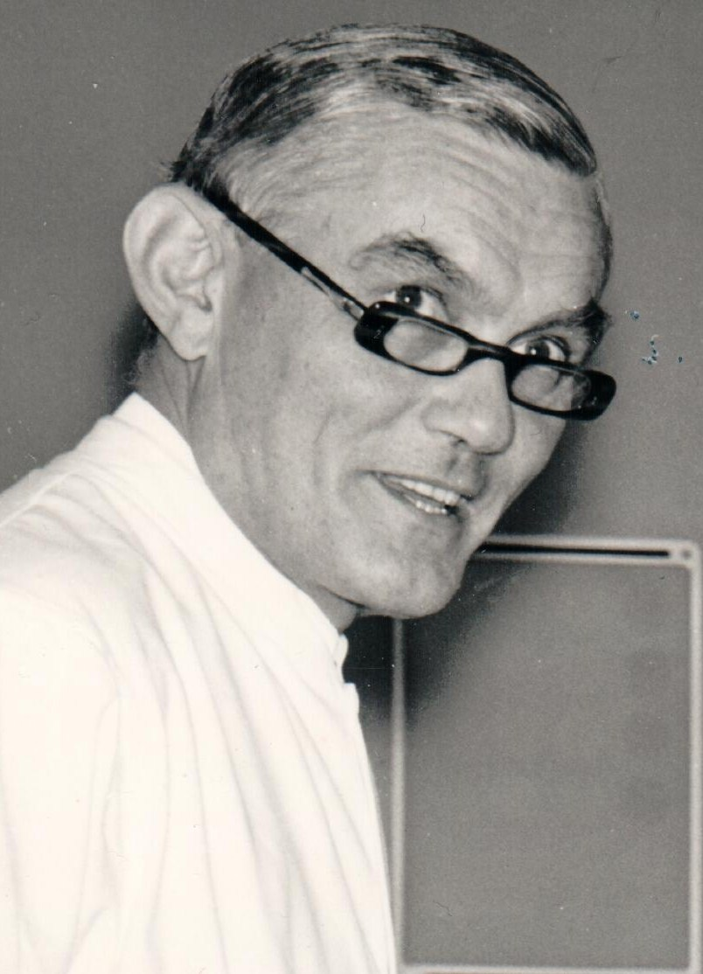
The Glostrup Population Studies
Per From Hansen
Notes:
DES began in 1975 in the team performing the Glostrup Population Studies, surveying cohorts, born in 1897, 1914 and later 1936.
The leader was Per From Hansen, who in 1959, age 39, became head of Medical Dept C, in the newly built, Glostrup Hospital. He would fight the epidemic of the century, ischemic heart disease, with inspiration from the Seven Countries Study. Can risk factors determined in middle aged men predict further heart diseases?
.

Slide 4
Leif Hagerup 1964
Survey of 802 50-year-old men and women
Notes:
One of his residents, Leif Hagerup, surveyed the 1914-cohort in 1964, inviting all 50-year-old men and women in the Glostrup admission area. - He became the first chairman of our Epidemiological Research Group in 1975

Slide 5
Copenhagen University Hospital in Glostrup
The Glostrup Population Studies
Notes:
In 1972 I got a training position in the coronary care unit of Glostrup Hospital, but I was more interested in the WHY young men got a myocardial infarction, than the HOW you should treat the arrhythmias to follow.

Slide 6
Finn Gyntelberg
The Copenhagen Male Study 1970
Notes:
Another trainee, Finn Gyntelberg, used epidemiological methods in a big survey of middle-aged men. He urged me: What happens to the 1914-cohort?

Slide 7
Marianne Schroll
Selfportrait 1964
Notes:
So I decided to ask Per From Hansen to give me a role in a survey of 60-year-olds. He made me principal investigator and helped me with ideas and his great knowledge about epidemiology. Leif Hagerup was preparing his thesis about the 1914 population, but took time and energy to secure uniformity of measurements in the same individiuals 1964 by him and age 1974 by me.

Slide 8
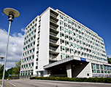
666 60-year-olds
The ten-year follow-up of the 1914-cohort
Staff
Localities
Funding
Epidemiological knowledge
Notes:
I obtained funding, found localities in the nurses apartments, employed and trained staff and gathered data from 666 60-year-olds.
But there was no education or courses or societies dealing with epidemiology in Denmark to help me with the analyses.

Slide 9
The 14th International Cardiovascular Ten-Day Teaching Seminar in Mexico
Hanne Hollnagel
Marianne Schroll
Notes:
Then I got the chance in 1975 to participate in the 14th International Cardiovascular Ten-day-teaching Seminar in Mexico - together with Hanne Hollnagel, who was going to be PI for the survey of 40-year-olds following my survey of the 60-year olds. I was very highly pregnant with my child no 4, but had to go, because the course was crucial for my transformation from a CLINICIAN into an EPIDEMIOLOGIST.

Slide 10
Ten-day epidemiological teaching seminar in Mexico 1975
Geoffrey Rose
Jerry Stamler
Rose Stamler
Archie Cochrane
Notes:
Geoffrey Rose from London School of Hygiene (seen at the left) and Jerry Stamler from Chicago (to the right) were leaders of the group of inspiring teachers

Slide 11
Per From Hansen Leif Hagerup Marie Eriksen Hanne Hollnagel Henrik Hoffmeyer Søren Kleven Grethe Hess
The Epidemiology Research Group
The Beginning in 1975
Notes:
Already during the survey of 60-year-olds, I started to invite people with experience in epidemiology home, around my dining table.
I told them about my results and asked for advice. In the beginning came researchers from The Glostrup Population studies: Per From Hansen, the head of dept., the investigators of the 50, 70 and 40 year-olds and the group of psychiatrists and psychologists from the psychiatric part of the surveys, at Nordvang.

Slide 12
Finn Gyntelberg Torsten Deckert Johannes Ipsen, Jørn Olsen, Svend Juul Anders Green, Jens Lauritzen Thorkild I.A.Sørensen Johs. Mosbech Gorm Jensen , Peter Schnohr Allan Krasnik Kjeld Kjeldsen Svend Larsen og Mogens Larsen Leif Mortensen Mette Madsen Michael Davidsen Jørgen Hilden
The Epidemiology Research Group
Established 12.03.1975
Notes:
We soon decided to invite guests, who talked about the epidemiological problems they were facing in their data collections.
I hope some of you in the audience are old enough to remember those days? Sorry, I have no foto’s
The group was interdisciplinary from the beginning. To mention a few: Finn Gyntelberg and the Copenhagen males, Torsten Deckert from Steno with diabetes epidemiology, Johannes Ipsen the first Danish professor in epidemiology, who brought among others Jørn Olsen and Svend Juul from Århus. Odense-people Anders Green, Jens Lauritzen, Thorkild I.A.Sørensen and his young men at session, Gorm Jensen and Peter Schnohr, when the Østerbro-surveys got started, Allan Krasnik talked about a project in Slagelse
– Johs Mosbech and Kjeld Kjeldsen administrators and --The statisticians from the big calculator at Herlev Hospital the Larsen brothers and Leif Mortensen, also Michael Davidsen, Mette Madsen, Jørgen Hilden
… I could go on
The meetings were successful, many of the invited speakers found the free way of discussion so good, that they stayed in the group.
The 12.03.1975 the group constituted itself as “Epidemiological Research Group” with the purpose to spread and maintain knowledge about statistical, epidemiological and social research methodology

Slide 13
14.12.1976 By-laws at Danish Institute for Clinical Epidemiology
Mette Madsen
DIKE
Notes:
The DES committee believed, that Ole Horwitz was founder of the society. Now I will explain, why:
In Glostrup a group of researchers followed cohorts born in 1897, 1914 and 1935. We needed a statistician for the analyses and I hired Mette Madsen in a ”permanent” position 1976 to 77. She was an eager participant in the meetings of the epidemiology research group; so when she got a better position at DIKE, she invited the group to meetings in the Prince Haralds Palæ at Svanemøllevej, where Ole Horwitz ,the director, was very kind and helped us to write the official by-laws, that still exist. We admired him for his research of the register of Tuberculosis and the register for causes of death.
Ole Horwitz taught us about the ”cigar method”, where powerful men, smoking their cigars made “guesstimates”. He impressed on us, the necessity to collect good data and analyze them correctly to obtain precise predictions. - He ran Eremitageløb, but fell lifeless to the ground. - In 1981 Finn Kamper Jørgensen became director of DIKE and continued to host some of the meetings in the epidemiology group

Slide 14
Danish Epidemiological Society
Purpose
Membership
Meetings
subcommittees
Notes:
According to the by-laws, the purpose was to disseminate knowledge of epidemiological methods to persons working with data collection in surveys, exchange experience with questionnaires, analytic methods, EDP, costs, as we had many methodological problems in common
Membership was obtained by presenting project plans or results from on-going data-collections in the group, answering spontaneous questions and comments The atmosphere was friendly and open. This constructive criticism was motivating for the speaker, who took the points, and for the audience who got some influence.
The themes of meetings could be: Non-participation and representativeness, experimental variation – clean dirt and dirty dirt, where dirty dirt is bias, regression towards the mean, conditions for use of multiple regression…
9 meetings a year were summarized by the secretary – ME – including points from the discussion and with documentation and literature references attached. I really learned during these years to dictate minutes to my secretary who wrote letters to 77 members and sent them via the hospital post.
A few subcommittess worked with problems raised during meetings, most important was the evaluation of diagnostic information in the Hospital patient Register for research purposes.

Slide 15
Executive committee
Leif Hagerup Marianne Schroll
Thorkild I.A.Sørensen
Johannes Ipsen Kjeld Kjeldsen
Thora Brendstrup
Mette Madsen
Notes:
Leif Hagerup was chairman 1975 – 1980. Then it was me. I was followed 1982 by Thorkild I. A. Sørensen. Committee-members during that time were prof. Johannes Ipsen, administrator Kjeld Kjeldsen, medical doctor Thora Brendstrup, statistician Mette Madsen.

Slide 16
And time went on
Glostrup
My own life
Epidemiology Research Group
Notes:
And time went on
In Glostrup
In my own life
The research group became a Society in 1992 and a new generation of epidemiologists took over:Per Krag Andersen, Knut Borch Johnsen, Merete Osler…

Slide 17
Research Center for Prevention and Health
1991 – 2017 Torben Jørgensen
Notes:
Per From Hansen died suddenly in 1983. I became leader of The Glostrup Population Studies, including three Monica surveys during which Torben Jørgensen examined all participants for gall stones. When I left, to become the first Danish professor of Geriatric Medicine in 1991, he took over and developed Research Center for prevention and health, that after his retirement was moved to Fredriksberg, forming Center for Clinical research and prevention.

Slide 18
Thesis 1982: A ten-year prospective study, 1964 – 1974, of cardiovascular risk factors in men and women from the Glostrup Population born in 1914
Notes:
In 1982 I defended my doctoral thesis on cardiovascular risk factors and became head of the geriatric department in Roskilde, where I live.

Slide 19
Professor of Geriatric Medicine 1991
Notes:
I became the first professor of Geriatric Medicine at Copenhagen University and Kommunehospitalet in 1991, but I continued to use epidemiology in my research
Maybe some Public Health researchers in the audience now use my department with the spacy handicap-toilets?

Slide 20
The 1914 cohort
www.gerodan.dk
Notes:
I followed the 1914-cohort untill the survivors were 100 years old and I wrote a book on successful aging about them, published when the Glostrup Polulation Studies turned 50 years in 1914. In the book I describe the start of the Glostrup Population studies and of DES

Slide 21
Danish Epidemiological Society
Schroll Prize for Excellence: To a junior epidemiologist who has demonstrated excellence in epidemiological teaching, research, methods development or dissemination
Notes:
The Danish Epidemiological Society was created in 1992 and now has 430 members.
At the previous general assembly it was decided to award a Prize for Excellence
The Schroll Prize recognizes a junior epidemiologist who has demonstrated excellence in epidemiological teaching, research, methods development or dissemination, and thus already contributed
To development of the field of epidemiology at an early stage of their career.
To be eligible the nominee must have completed their PHD within 4 years at the time of nomination. Parental leave after completion of the PHD or similar, may be taken into account and the number of weeks of parental leave may be multiplied by two. The nominee must be employed at a Danish research institution at the time of nomination. The selection of the Awardees will be made solely on the basis of the candidate’s scientific and professional accomplishments without regard to race, gender, nationality, geographic location or religious or political views.
I will now give the chair to Stine Schramm. She will give the scientific committee’s reasons for the nomination of the chosen researchers.

